Slide 1
Diabetes
Health through science
Presented by: Despina Kochova
Skopje, Republic of Macedonia

Slide 2
What is diabetes?
Health through science
Diabetes is the world's leading syndrome, which occurs as a result of highly increased blood glucose, which is kept in the blood instead of being transmitted to all parts of the body.
There are several types of diabetes, but the most widespread and most dangerous is type 2 diabetes or INDMD.
What is diabetes mellitus type 2?
INZDM is the most common form of this disease, which is characterized by loss of ability of the body to appropriately use insulin or insufficient secretion of insulin by the pancreas.

Slide 3
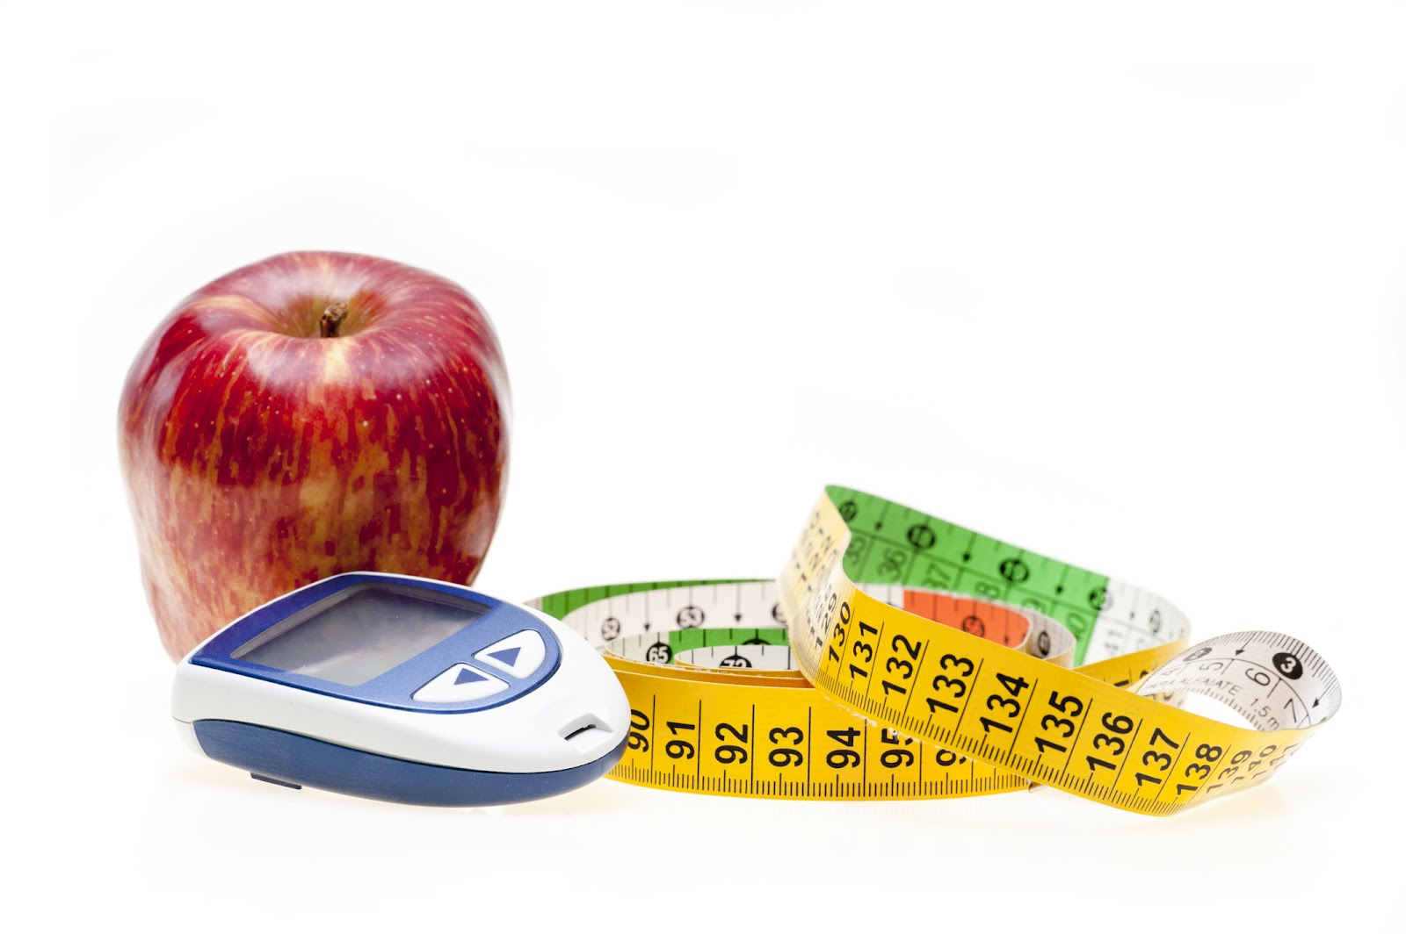
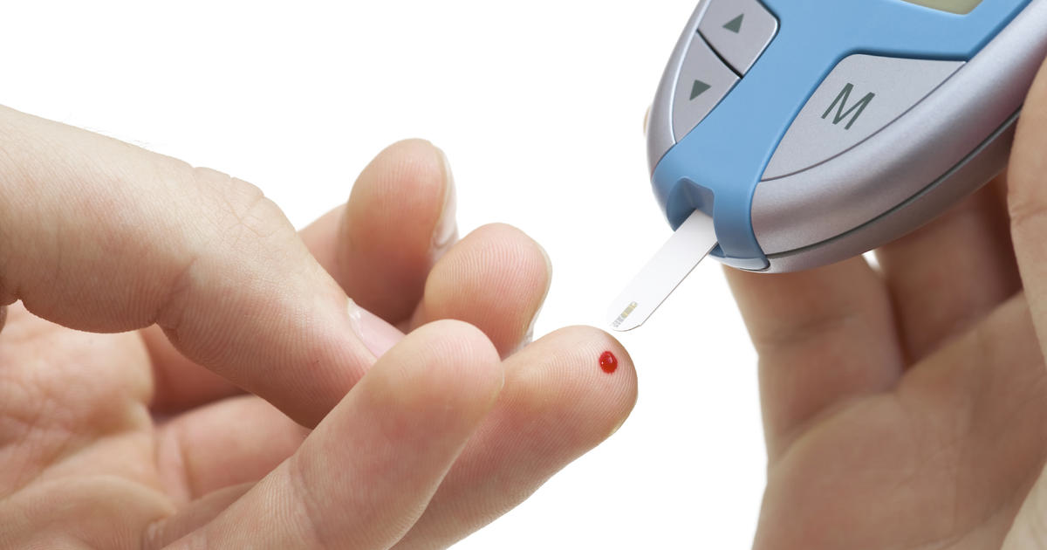
Health through science
What are the symptoms of the existence of this disease?
Thirst, hunger
Increased urination
Weight loss
Fatigue
Problems with vision
Hyperglycemia
Urinary tract infections and urinary tract (most common in elderly patients)
Change in skin color

Slide 4
Health through science
Causes of diabetes
Representation
The most common reasons for the emergence of a wound type are:
Family history
Absence of physical activity
Overweight
Unhealthy diets
About 422 million people worldwide have diabetes, of which 90% are diabetes type2. Globally, according to recent studies, it has been proven that more and more young children suffer this type of diabetes.

Slide 5
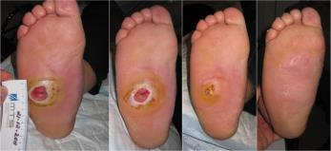
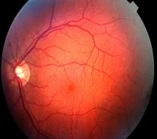
Health through science
What are the consequences of diabetes?
The increased amount of blood sugar has major consequences for the body:
Damage to eyesight, kidneys, nerves, cardiovascular system
Amputation of some parts of the body, most often toes
Nerve damage

Slide 6
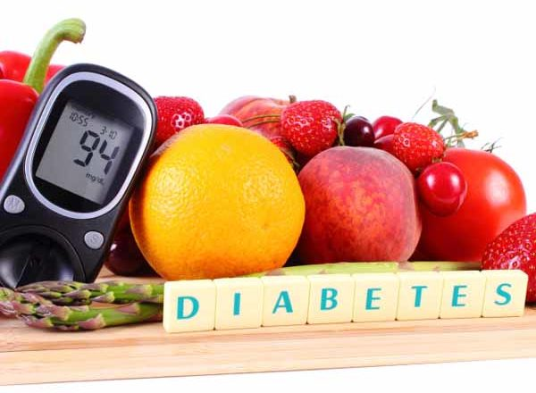
Health through science
How to protect yourself?
Increased physical activity - 30 minutes of physical activity per day
Healthy eating-avoid sweets, reduce carbs and eat more protein and fiber
Medical examinations
Taking appropriate medications
Avoid smoking, which increases the risk of this disease.

